Slide 1
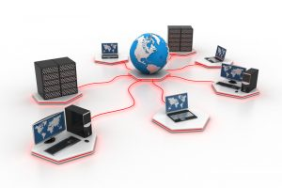
USES AND BENEFITS OF NETWORK

Slide 2
COMPUTER NETWORK
A network consists of two or more computer that are linked in order to share resources (such as printers and CDs), exchange file, or allow electronic communications.
The computer on a network may be linked through cables,telephone lines, radio waves, satellites etc.
A popular example of a computer network in the Internet,which allows millions of user to share information.

Slide 3
USES OF COMPUTER NETWORK
We can share resources such as hardware devices, software programs,data and information with help of the network.
Hardware sharing
In a networked environment,each computer can access and use one or more hardware on the network,e.g printers.

Slide 4
Software Sharing
Networks enable pepole to gain access to programs stored on a central computer,such as a spreadsheet or word processing program,antivirus etc. an organiztion for instance can aviod having to install a copy of the program on each worker’s computer.

Slide 5
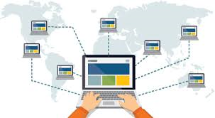
BENEFITS OF NETWORK
Easy access
Information stored in a network can be easily acceessed from other computers.

Slide 6
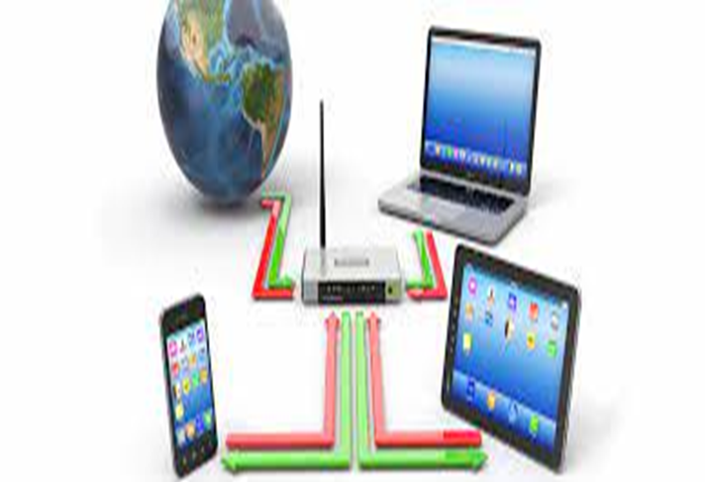
•Productivity
It enhances the productivity of workers, by letting employees exchange information and communicate more easily.

Slide 7

•Sharing of programs
Programs stored on the central system can be shared with other computer system.

Slide 8

• Cost
Users can share resources, such as printers and hard drives.it helps to reduce the cost of buying computer.

Slide 9

•Security
The security program helps to prevent unauthorized users from accesing information on the network.

Slide 10

•Backup
Many networks backup information on a central computer. when a backup is performed only the information on the central computer needs to be backed up.

Slide 11
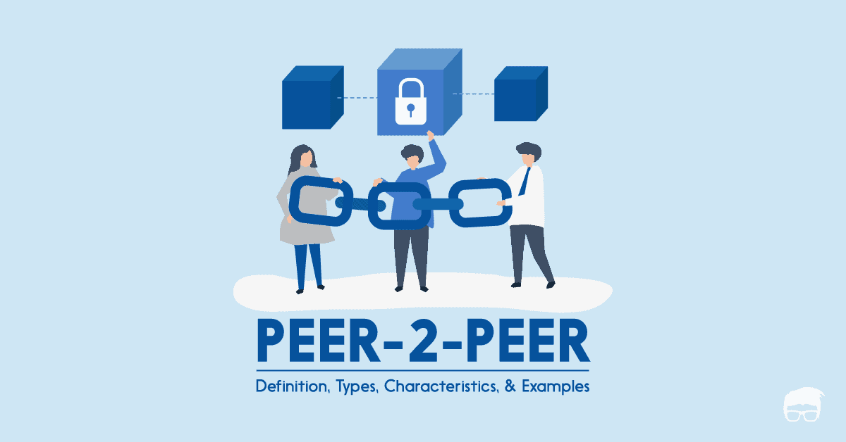
PEER TO PEER

Slide 12
PEER TO PEER
Peer to Peer is an approach to computer networking where all computers share equivalent responsibility for processing data. Peer- to -peer networking

Slide 13
Characteristics of a Peer Network
Peer to peer networking is common on small local area networks (LANs),particularly home networks .Both wired and wireless home networks can be configured as peer to peer environments.

Slide 14
Benefits of a Peer to Network
You can configure computers in peer-to-peer workgroups to allow sharing of files,printers and other resources across all the devices. Peer networks allow data to be shared easily in both directions,whether for downloads to your computer or uploads from your computer.

Slide 15
Advantages of Peer to Peer network
1.It is esay to install and so is the configuration of computers on this network,
2.All the resources and contents are shared by all the peers ,unlike server-client where server shares all the contents and resources.
3.P2P is more reliable as central dependency is eliminated. Failure of one peer doesn’t affect the functioning of other peers.
4.There is no need for full-time System Administrator. Every user is the administrator of his machine. User can control their shared resources.
5.The over-all cost of building and maintaining this type of network is comparatively very less.

Slide 16

•Because each computer might be being accessed by others it can slow down the performance for the user
•
•Files and folders cannot be centrally backed up
Security is not good, and you can set passwords for files that you don’t want people to access but apart from that the security is poor.

Slide 17
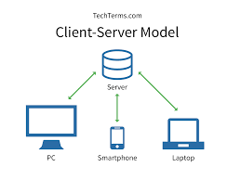
Server-Client Based Network

Slide 18
Server-client based Network
The term client-server refers to a popular model for computer networking that utilizes client and server devices each designed for specific purposes.
The client-server model can be used on the Internet as

Slide 19
Characteristics of a client-server
•Sends request to the server
•It experts and receives responses from the server.

Slide 20
Benefits Of Client Server
•All data are centralized on a single server, simplifying security checks and update data and software.
•The technology supporting the clients-server are more mature than others.
•A level administration server, customers have little importance in this model, they have less need to be administered

Slide 21
Advantages of client-server
•A client server enables the roles and responsibilities of a computing system. This means that it can update all the computers connected to it. An example of this would be software updates or hardware updates.
•The security is a lot more advanced than a peer to peer network. you can have passwords to your won profile so that no one can access everything when they want. And the level off access range in different organizations
•Many mature client-server technologies are already available which were designed to ensure security, ‘friendliness’ ogf the user interface, and ease of use

Slide 22
Disadvantages of clients-server
•When the server goes down or crashes. All the computers connected to it become unavailable to use
•More expensive than a peer to peer network. you have to pay for start up cost
•When you expand the server, it starts to slow down due to the to the Bit rate per second.

Slide 23
Thank you

